Slide 1
Object-Oriented Programming Concepts
Message Passing

Slide 2
Objectives
Understand Message Passing and Method call
Understand static binding and dynamic binding
Use real life examples

Slide 3
Introduction to Message Passing
Recall that object-oriented programming as a programming paradigm is based on objects.
Objects are a representation of real-world that communicate with each other.
In OOP, objects communicate with each other via messages.
  Objects communicate with one another by sending and receiving information to each other.
  A message for an object is a request for execution of a procedure by invoking a function in the receiving object that generates the desired results.

Slide 4
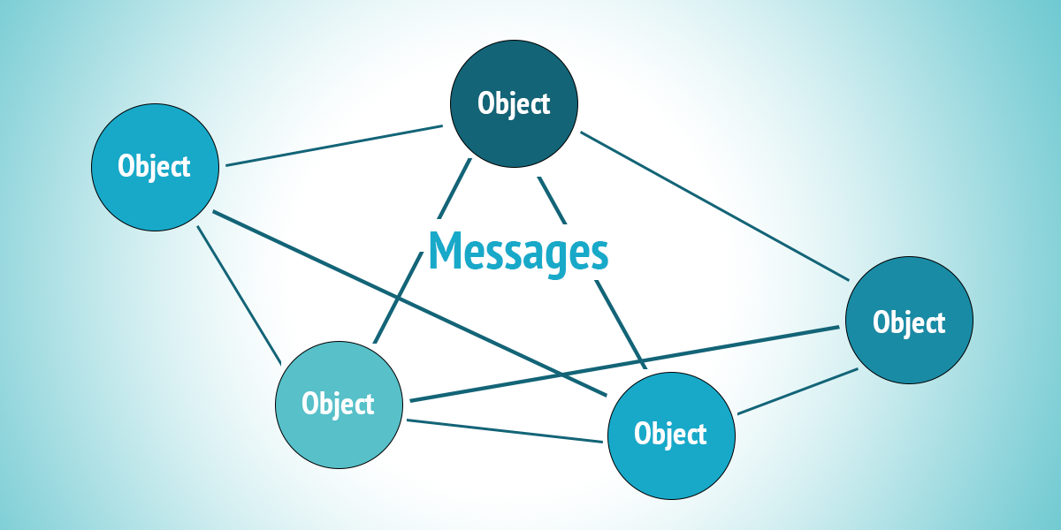

Slide 5
Introduction to Message Passing
Definition: Message passing is a way by which parts of a program can communicate with each other.
  In C/C++/Java etc, messages are arguments that are evaluated before the message is sent ( or passed on to the called function).
  A message is simply a method call on an object especially in languages like Smalltalk.

Slide 6
Introduction to Message Passing
Two or more objects communicate with each other through sending and receiving messages.
  Sending object (Object A) knows which method of receiving object (Object B) is being called.
  This is often called method calling.
Message passing involves specifying the name of the object, the name of the function and the information to be sent.
  Example: student.mark(name);
  In this example, student is object, mark is the name of the function (message) and name is information.

Slide 7
Example 1
#include<iostream>
using namespace std;
class College{
private:
public:
void getFees(double d)
{
cout<<"Fees are: "<<d<<endl;
}
};
class Student{
private:
public:
double payFees()
{
double Fees;
cout<<"Enter fees: "<<endl; cin>>Fees;
return Fees;
}
};
int main()
{
College c;
Student s;
c.getFees(s.payFees());
}
In this example, class College which has a method "void getFees(double)", and another class named Student has a method "double payFees()"

Slide 8
Binding
Binding refers to mapping of one thing to another.
In programming, binding is the association of method call to the method body.
In the context of compiled language, binding is the link between the a function call and the function definition.
There are two types of binding:
  Static Binding (early) that happens at compile time
  Dynamic Binding (late) that happens at runtime.

Slide 9
Static versus Dynamic Binding
The main differenced between static and dynamic binding are:
  Static binding happens at compile-time whereas dynamic binding happens at run-time.
  In static binding, the function definition and the function call are linked during the compile-time whereas in dynamic binding the function calls are not resolved until runtime.
  Static binding happens when all information needed to call a function is available at the compile-time whereas dynamic binding happens when all information needed for a function call can not be determined at compile-time.
  Static binding can be achieved using normal function calls , function overloading and operator overloading whereas dynamic binding can be achieved using virtual functions.

Slide 10
Static versus Dynamic Binding
  Static binding results to faster execution of program since all information needed to call a function is available before run-time whereas dynamic binding results to somewhat slower execution of code since a function call is not resolved until run-time.
  Dynamic binding is flexible since a single function can handle different types of objects at run-time hence significantly reducing the size of codebase and makes the code ore readable

Slide 11
Example 1 : static binding
#include <iostream>
using namespace std;
class ComputeSum{
public:
int sum(int x, int y)
{
return x + y;
}
int sum(int x, int y, int z)
{
return x + y + z;
}
};
int main()
{
ComputeSum obj;
cout << "Sum is " << obj.sum(10, 20) << '\n';
cout << "Sum is " << obj.sum(10, 20, 30) << '\n';
return 0;
}
In this example, the function sum is overloaded to accept two and three integer arguments. Even though there are two functions with same name inside the Computesum class, the function call sum() binds to the correct function depending on the parameters passed to those functions. This binding is done statically during compile time.

Slide 12
Dynamic Binding
Example 2 : Dynamic binding
Consider a program that has a base class B and derived class D. base class B has a virtual function f() which is overridden by function in the derived class D: i.e. D::f() overrides B::f(). Consider line 30-35 where the decision as to which class’s function will be invoked depends on the dynamic type of object pointed to by baseptr. This information can only be available at run-time and hen is subjected to dynamic binding.ce the function f()

Slide 13
Example 2 : Dynamic binding
#include <iostream>
using namespace std;
class B{
public:
// Virtual function
virtual void f()
{
cout << "Base class function called.\n";
}
};
class D: public B{
public:
void f()
{
cout << "Derived class function called.\n";
}
};
int main()
{
B base;
D derived;
B *basePtr = &base;
basePtr->f();
basePtr = &derived;
basePtr->f();
return 0;
}

Slide 14
References
https://www.geeksforgeeks.org/object-oriented-programming-in-cpp/
http://www.panonit.com/blog/overview-message-passing-object-oriented-programming
http://www.cplusplus.com/forum/general/199865/

